Slide 1
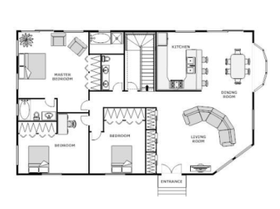
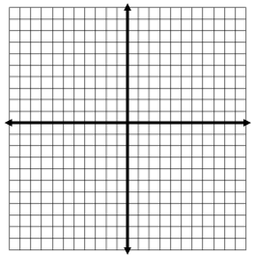
Parallel and Perpendicular Lines
Find 3 sets of parallel lines and 3 sets of perpendicular lines.
Is it important that these lines are parallel or perpendicular? What would happen if they weren’t?
_____________________________________________________________________________________
_____________________________________________________________________________________
_____________________________________________________________________________________
_____________________________________________________________________________________
Graph the following equations
y = 2x + 8
3y -6x = -12
y = x + 5
2y -6x = -12
Parallel or not parallel? Parallel or not parallel?
Is there anyway you can tell they are parallel by looking at the equation?
___________________________________________________________________________________

Slide 2
Write an equation of a line that is parallel to the line y = 5x+4
Write the equation of a line parallel to the y-axis
Write an equation of a line that is parallel to the line 2y = 3x + 6
Which equation represents a line that is parallel to the line y = -4x+5?
(1) y = -4x+3 (2) y = $\frac{1}{4}x$+3 (3) y = $−\frac{1}{4}x$+5 (4) y = 4x+5
2. Which equation represents a line parallel to the x-axis?
(1) x = 5 (2) y = 10 (3) x = $\frac{1}{3}y$ (4) y = 5x + 17
3. Which equation represents a line that is parallel to the line whose equation is 2x+3y = 12?
(1) 6y – 4x = 2 (2) 6y + 4x = 2 (3) 4x – 6y = 2 (4) 6x + 4y = -2
Are the following lines parallel or not parallel: y = $\frac{1}{3}$x + 8 and 9y + 4 = 3x – 1 ?
Are the following lines parallel or not parallel: 3y = 6x + 2 and -2x = 4x + 6 ?

Slide 3
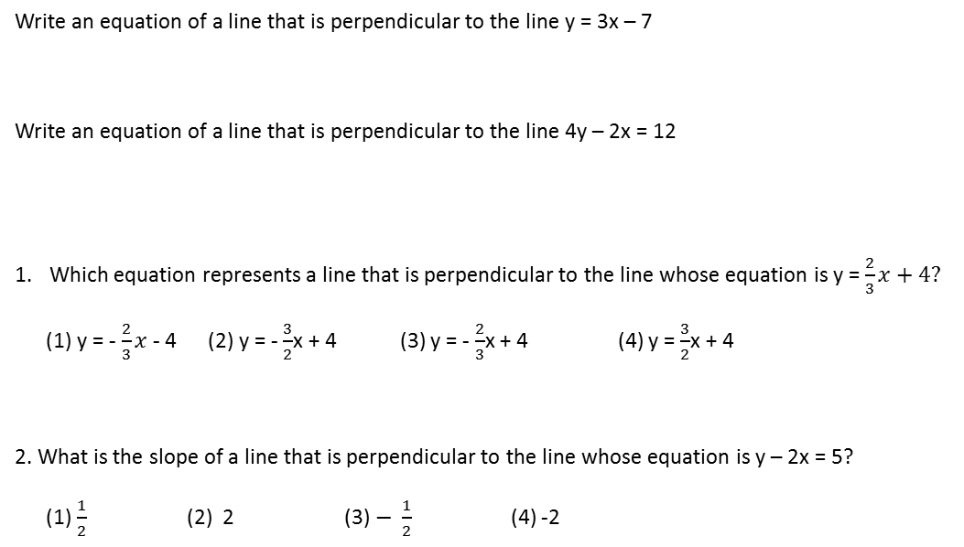
y = 2x + 8
6y -3x = -12
y = 2x + 5
4y + 2x = -12
Perpendicular or not?
Perpendicular or not?
Is there anyway you can tell they are parallel by looking at the equation?
___________________________________________________________________________________
|
Perpendicular ______________________________________________________________________
__________________________________________________________________________________
Write an equation of a line that is perpendicular to the line y = 3x – 7
Write an equation of a line that is perpendicular to the line 4y – 2x = 12
Which equation represents a line that is perpendicular to the line whose equation is y = $\frac{2}{3}x+4?$
(1) y = -$\frac{2}{3}x$- 4 (2) y = - $\frac{3}{2}$x + 4 (3) y = - $\frac{2}{3}$x + 4 (4) y = $\frac{3}{2}$x + 4
2. What is the slope of a line that is perpendicular to the line whose equation is y – 2x = 5?
(1) $\frac{1}{2}$ (2) 2 (3) $− \frac{1}{2}$ (4) -2

Slide 4
Point Slope Formula
$y −y_{1}$ $=m(x−x_{1})$
What is the equation of a line that passes through the point (-3,-11) and is parallel to the line whose
equation is 2x – y = 4?
What is the a line that passes through the point (6,-5) and is parallel to the line whose equation is
2x – 3y = 9
YOU TRY!
What is the equation of a line that passes through the point (5,-2) and is parallel to the line whose
equation is 2x + 5y = 10
Write the equation of a line that is parallel to the line 6 + 2y = 4x and goes through the point (2, –3).
What is the equation of a line that is perpendicular to the line whose equation is y = $\frac{3}{5}$x -2 and passes
through the point (3,-6)?
What is the equation of a line that passes through the point (4,2) and is perpendicular to the line
represented by the equation $y=− \frac{1}{2}+3$?
What is the equation of a line perpendicular to the line x = 5 and passing through the point (-1, -2)?

Slide 5
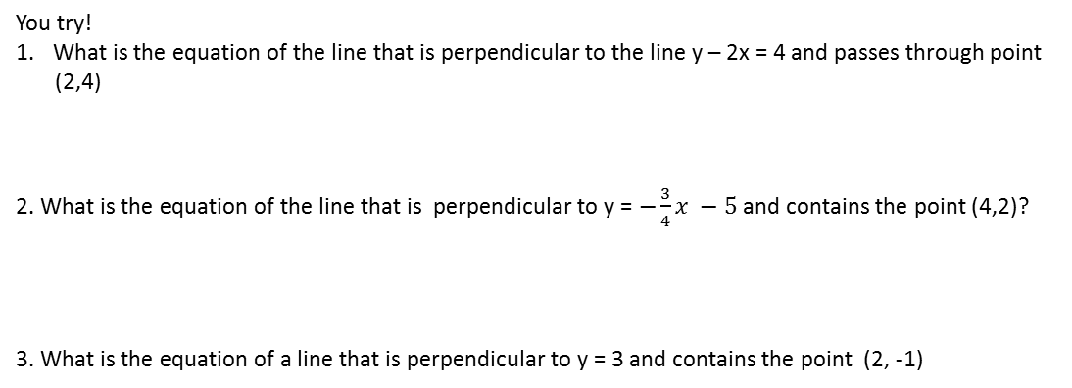
You try!
What is the equation of the line that is perpendicular to the line y – 2x = 4 and passes through point
(2,4)
2. What is the equation of the line that is perpendicular to y = $−\frac{3}{4}x −5$ and contains the point (4,2)?
3. What is the equation of a line that is perpendicular to y = 3 and contains the point (2, -1)
Write an equation of the line that passes through the point (6,-5) and is parallel to the
line whose equation is 2x – 3y = 11
Decide whether the following lines are parallel, perpendicular, or neither.
y = $\frac{1}{3}$x + 12 and 6y = - 2x + 6
What is an equation of the line that passes through the point (-2,5) and is perpendicular to the line whose equation is y = $\frac{1}{2}x$ + 5
Find an equation of the line passing through the
point (6,5) and perpendicular to the line whose
equation is 2y + 3x = 6

Slide 6
Name______________________________________________
What is the slope of a line perpendicular to the line whose equation is y = $−\frac{2}{3}x −5?$
(1) $−\frac{3}{2}$ (2) $−\frac{2}{3}$ (3) $\frac{2}{ 3}$ (4) $\frac{3}{2}$
2. Write the equation of the line parallel to y = $−\frac{3}{4}x −5$ that contains the point (4, 2)
3. What is the slope of a line perpendicular to the line whose equation is 5x + 3y = 8
4. Which equation represents a line parallel to the line whose equation is 2y – 5x = 10
5y – 2x = 25 (2) 5y + 2x = 10 (3) 4y – 10x = 12 (4) 2y + 10x = 8
5. Write the equation of the line that is perpendicular to 2y – 4x = 8 and contains the point (6,-6)

