Slide 1
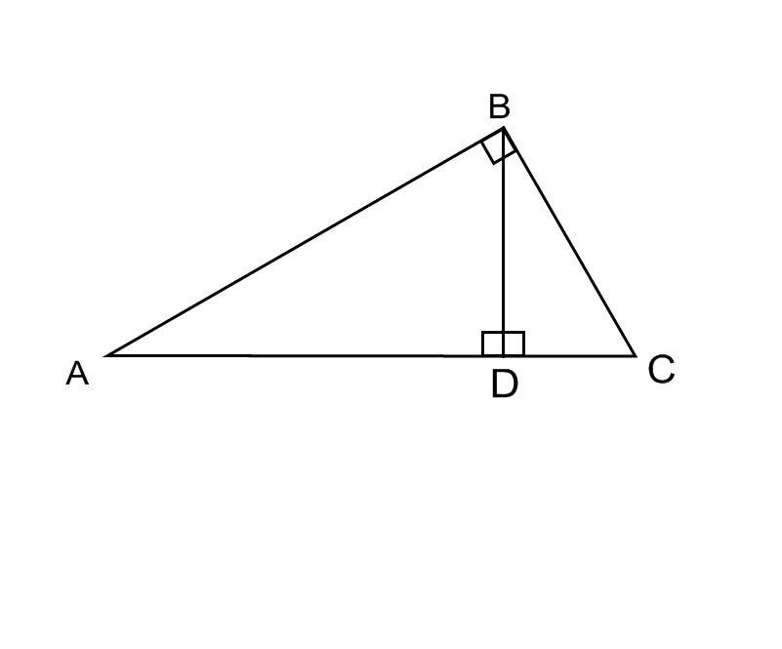
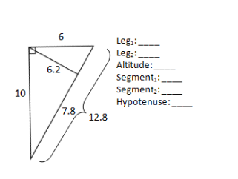
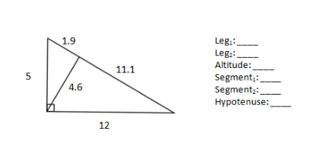
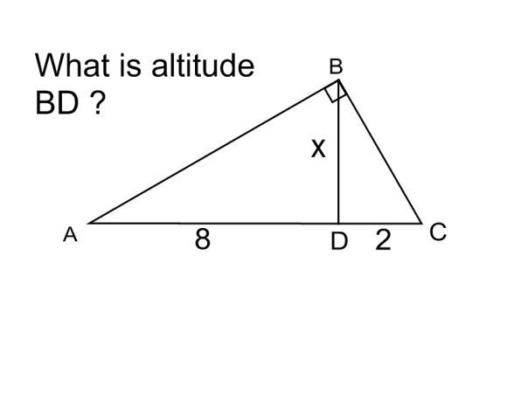
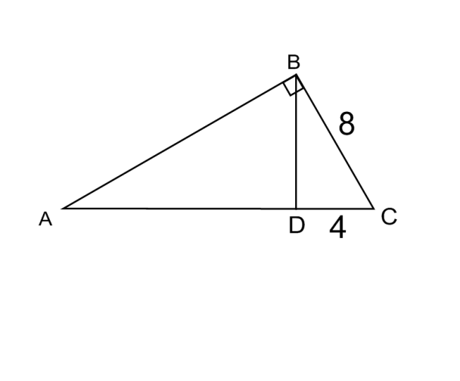
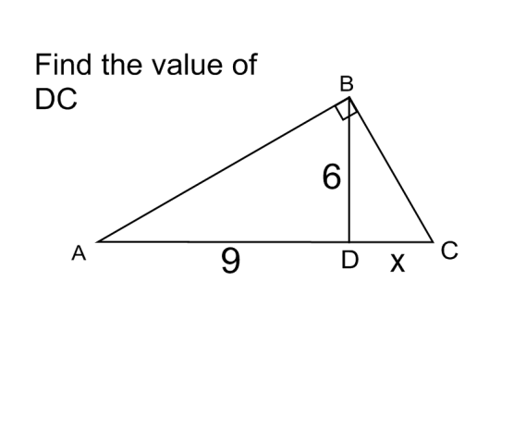
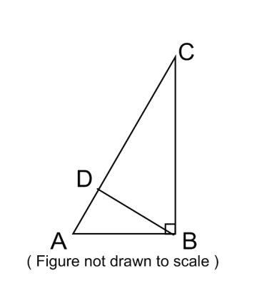
Right Triangles with an altitude drawn.
Mean Proportional
There are _____ triangles involved. These triangles are all _______ which means they are _______________.
Label the following on triangle ABC
Hypotenuse (h)
Legs (l1 and l2)
Altitude (a)
Segments (s1 and s2
Label the following
A
Proportions
(1) ____________ = ____________ 2) ___________ = ___________
Find the length of the hypotenuse AC
If hypotenuse AC = 12, AD = 3,
find the leg AB.

