Slide 1
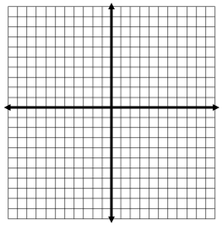
Distance Formula
When do we need to find out distances?
Find the length of the segment with endpoints (2,3) and (5,7)
Distance Formula:
Examples:
Find the distance of the line segment with the endpoints (5, -1) and (-2, 4)
Find the distance of the line segment with the endpoints (-4, -5) and (3,6)
Find the distance of the line segment with the endpoints (10, -6) and (-2. 15)

