Slide 1
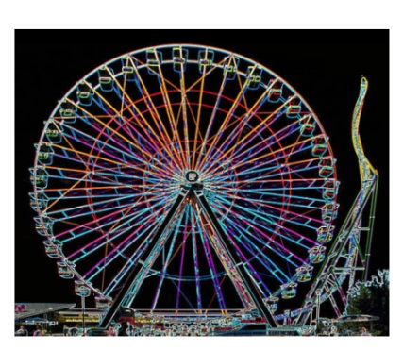
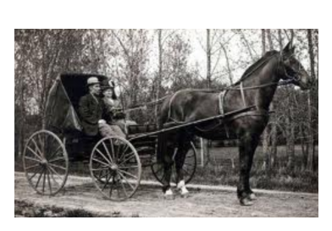
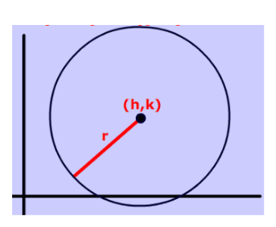

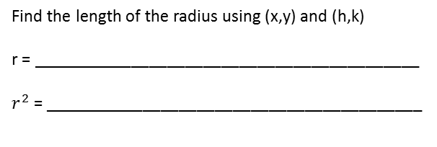
Equation of a Circle
Distance Formula :
Find the length of the radius using (x,y) and (h,k)
r = ___________________________________________
$r^{2}$ = __________________________________________
(x,y)
We need 2 things if we want the equation of a circle __________________ and __________________
Find the equation of the circle for the following:
center radius Equation
(6,2) 4 __________________________________
(-3,7) 2 __________________________________
(9,-1) 7 __________________________________
(0,0) 6 __________________________________
Origin 5 __________________________________
(-3, 0) 3 __________________________________
(-4,-5) $\sqrt{10}$ ___________________________________

Slide 2
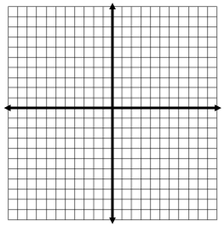
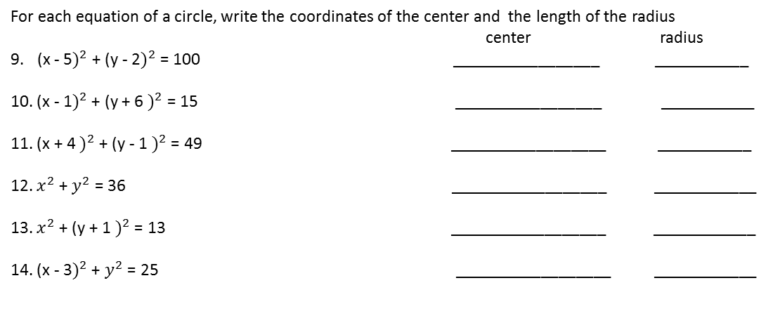
For each equation of a circle, write the coordinates of the center and the length of the radius
center radius
(x - 5$)^{2}$+ (y - 2$)^{2}$ = 100 _________________ ___________
10. (x - 1$)^{2}$ + (y + 6 $)^{2}$ = 15 _________________ ___________
11. (x + 4 $)^{2}$ + (y - 1 $)^{2}$ = 49 __________________ ___________
12. $x^{2}$ + $y^{2}$ = 36 __________________ ____________
13. $x^{2}$ + (y + 1 $)^{2}$ = 13 __________________ ____________
14. (x - 3$)^{2}$ + $y^{2}$ = 25 __________________ ____________
1) (x - 2$)^{2}$ + (y - 1 $)^{2}$ = 9
2) $x^{2}$ + $y^{2}$ = 25
r = ______
center:
________
r = ______
center:
________
3) (x + 2$)^{2}$ + (y +4 $)^{2}$ = 4
4) (x - 1$)^{2}$ + $y^{2}$ = 49
r = ______
center:
________
r = ______
center:
________

Slide 3
What is the length of a line segment with endpoints (-2, -6) and (3,9)?
(x - 3$)^{2}$ + (y - 4 $)^{2}$ = 25
r = ______
center:
________
Solve the following system of equations
(x + 4$)^{2}$ + (y - 1$)^{2}$ = 16
x = -4
Solution __________________

