Slide 1
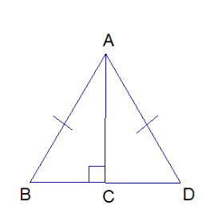
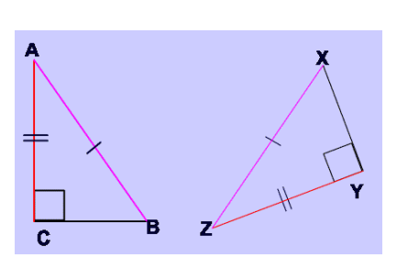
Name____________________________
Given: AB $≅$ AD and AC | BD
Prove: $BC ≅DC$
HL Proof
S
R
AC | BD
given
<ACB and <ACD are right <s
Def of |
$∆ACB$ and $∆ACD$ are
right triangles
Right triangles have
right angles
H
AB $≅$ AD
given
L
AC $≅$ AC
Reflexive Property
$$∆ABC ≅ ∆ADC$$
HL
$$BC ≅DC$$
CPCTC
Given: AC $≅$ ZY , AB $≅$ZX, AC | CB and ZY | XY
Prove: <Z $≅$ <A

Slide 2
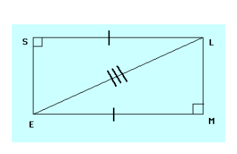
Given: SL $≅$ EM and ES | SL and LM | EM
Prove: $SE ≅ML$
NOT HL – CAREFUL!
A
Given: AB | BD and CD | DB. AC bisects BD
Prove:
$<A ≅ <C$
E
D
B
C

