Slide 1
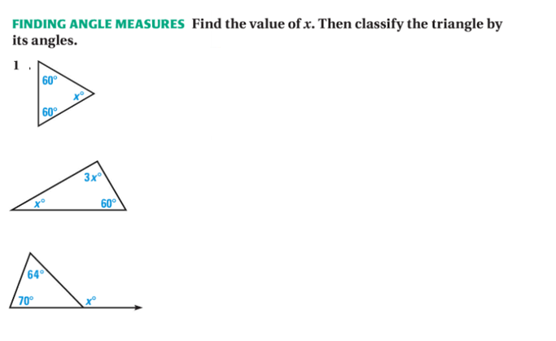
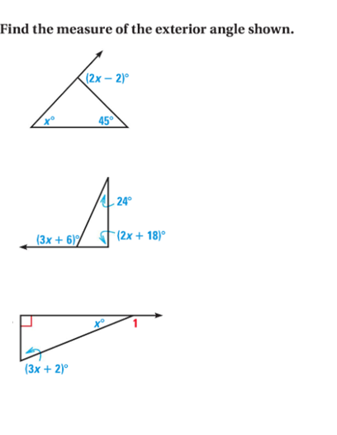
Name ________________________ Desmond - Geometry
MD HW 4.1 Classifying Triangles and Ext Angles
2.

Slide 2
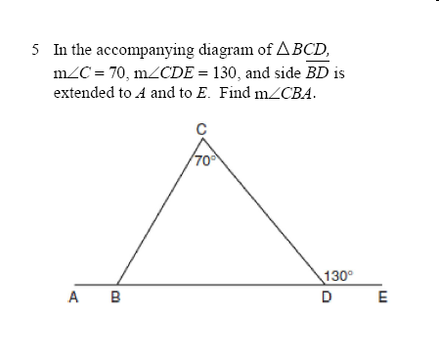
3.
4.

