Slide 1
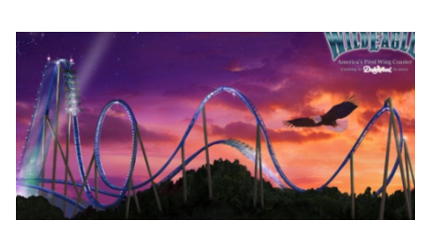
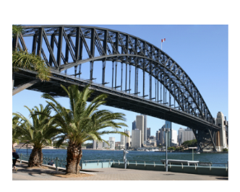
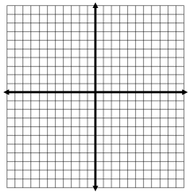
Parabolas – Quadratic Equations
Parabola is the shape of a curve. A quadratic equation is how you can create a parabola.
Why might is be important to have an exact equation when building parabolic shapes such as a bridge or a roller coaster?
y = $x^{2}−2x −3$
y = $x^{2}−6x+10$
y + x - 4 = 0

Slide 2
y = $x^{2}−4x$
x = 4
$$y=(x+3)^{2}−4$$
$y=2x+5$
Solver ____________________
Checker ___________________
Solver ____________________
Checker ___________________
y = $x^{2}+4x−5$
y = x - 1
y + 6x = $x^{2}+5$
2x + y = 5
Solver ____________________
Checker ___________________
Solver ____________________
Checker ___________________

