Slide 1
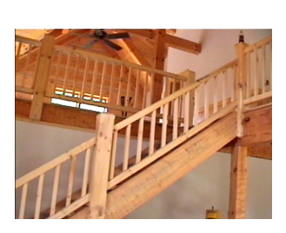
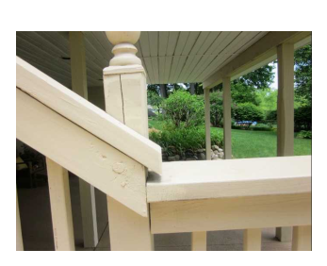
Angles
Y
Naming Angles
C
X
A
Z
B
Classifying angles
Q
m < x = 90 m < y = 180 m< a = 70 m<b = 120
Use the given information to find the indicated angle measure
F
M<FEG = ________
E
45
79
G
G

Slide 2
Bisect - ____________________________________________________________________________
BC bisects angle ABD. Find the measure of angle ABC
C
C
A
X + 10
D
A
9x – 4
6x + 23
D
2x - 5
B
B
Supplementary - ___________________________________________________________________
x
65
x
120
5x + 3
4x - 3
6x - 30
8x
Complementary__________________________________________________________________
2x - 20
x -10
X + 20
2x - 20

Slide 3
Cut two intersecting lines through your cookie. What do you notice about the opposite angles? Write a conjecture Draw a picture
____________________________________________
____________________________________________
____________________________________________
_____________________________________________
Vertical angles ___________________________________________________________________
W
As shown in the diagram, XY and WZ intersect
at E. If m<XEW is represented by 2x + 40 and m<ZEY
by 6x – 20, find the measure of m<XEZ
x
E
Y
Z
The measure of two vertical angles are represented by 3x – 10 and x + 30, find the value of x.
AB and CD intersect at E. If m<CEB is represented by 5x – 8 and m<AED is represented by x + 36, find
the value of x.

